Slide 1
Numerical Random Variables Continued

Slide 2
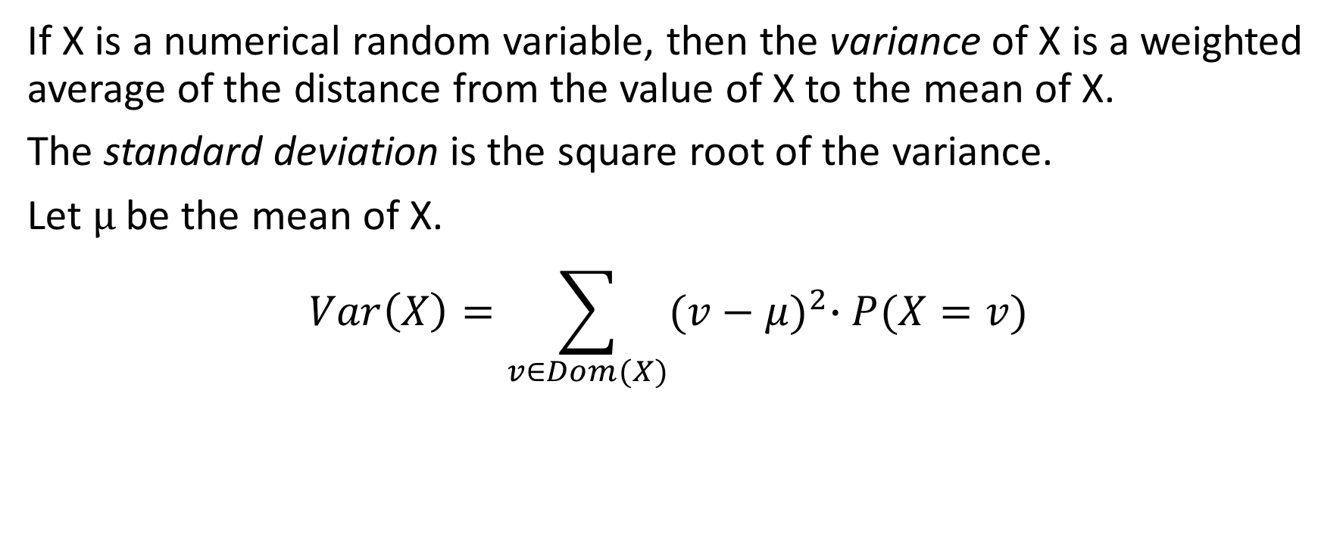
Variance: A measure of spread
If X is a numerical random variable, then the variance of X is a weighted average of the distance from the value of X to the mean of X.
The standard deviation is the square root of the variance.
Let μ be the mean of X.
$$Var\left(X\right)=\sum_{v∈Dom(X)}{{(v−μ)}^{2}∙P(X=v)}$$

Slide 3
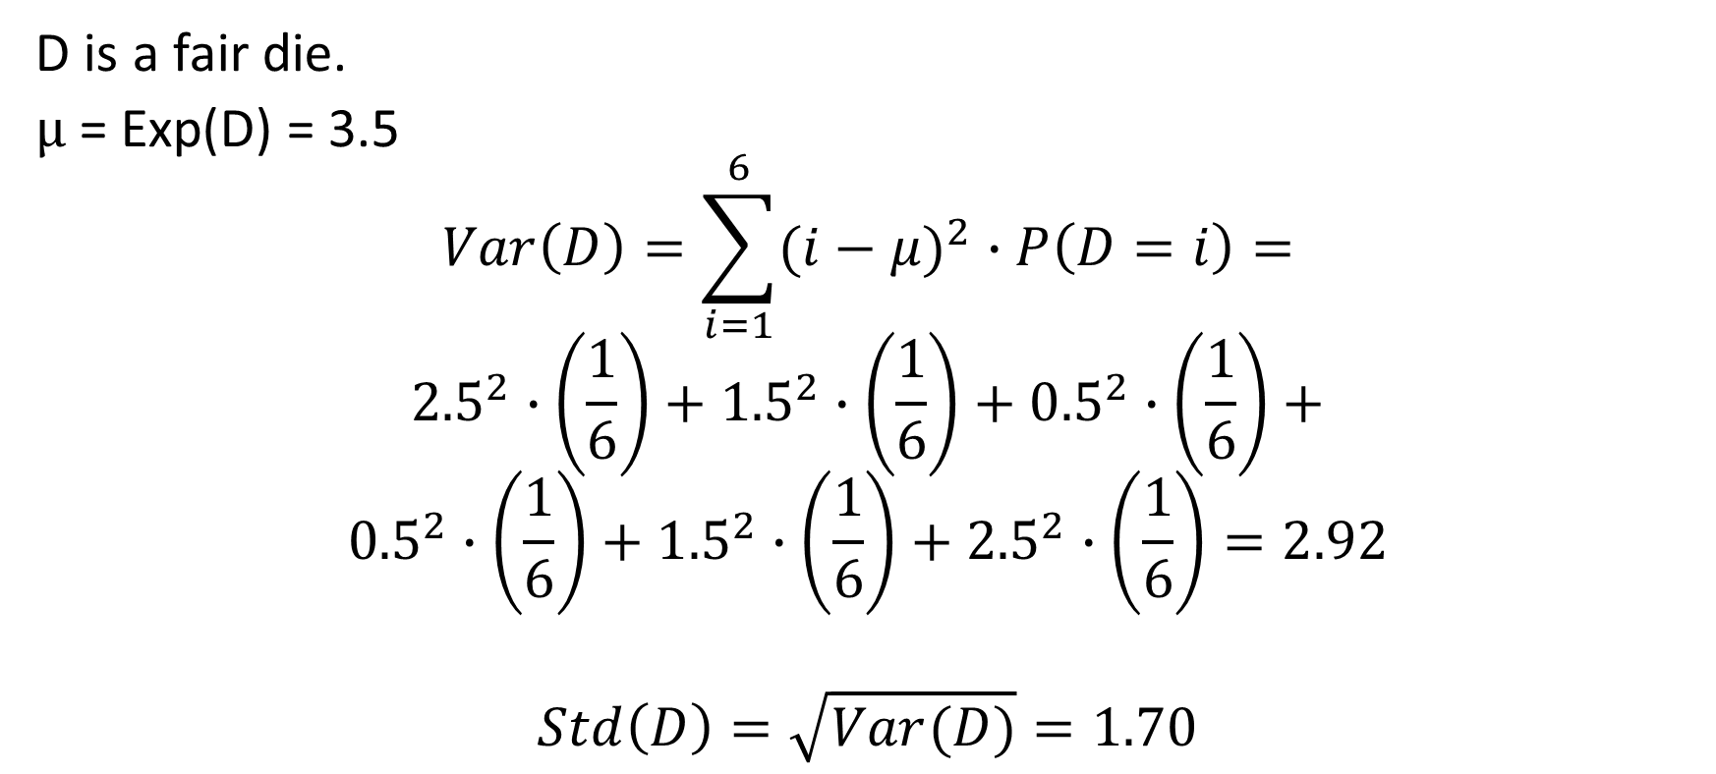
Examples of variance
D is a fair die.
μ = Exp(D) = 3.5
$$Var\left(D\right)=\sum_{i=1}^{6}{(i−μ)^{2}∙P\left(D=i\right)}=$$
$${2.5}^{2}∙\left(\frac{1}{6}\right)+{1.5}^{2}∙\left(\frac{1}{6}\right)+{0.5}^{2}∙\left(\frac{1}{6}\right)+$$
$${0.5}^{2}∙\left(\frac{1}{6}\right)+{1.5}^{2}∙\left(\frac{1}{6}\right)+{2.5}^{2}∙\left(\frac{1}{6}\right)=2.92$$
$$Std\left(D\right)=\sqrt{Var(D)}=1.70$$

Slide 4
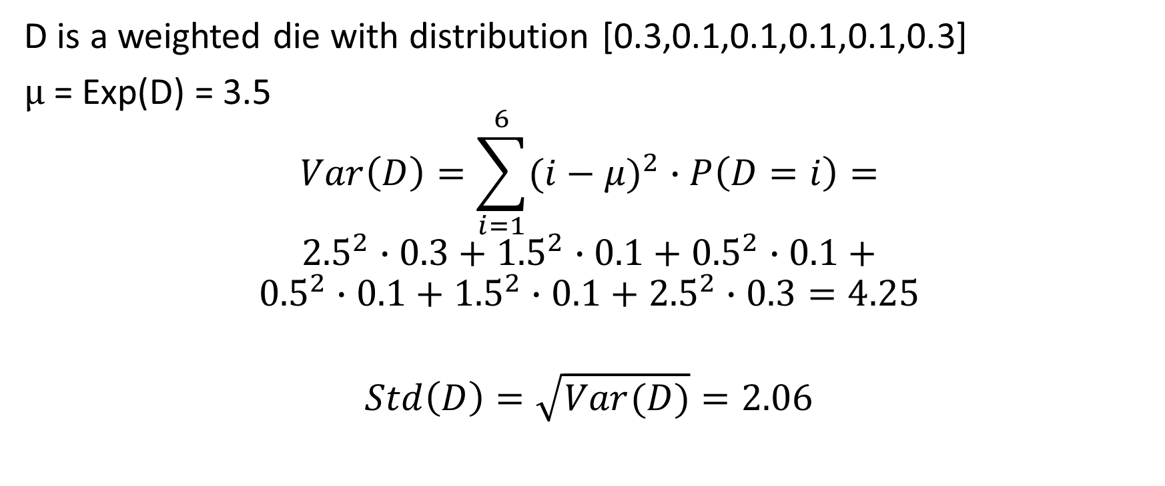
Examples of variance
D is a weighted die with distribution [0.3,0.1,0.1,0.1,0.1,0.3]
μ = Exp(D) = 3.5
$$Var\left(D\right)=\sum_{i=1}^{6}{(i−μ)^{2}∙P\left(D=i\right)}=$$
$${2.5}^{2}∙0.3+{1.5}^{2}∙0.1+{0.5}^{2}∙0.1+$$
$${0.5}^{2}∙0.1+{1.5}^{2}∙0.1+{2.5}^{2}∙0.3=4.25$$
$$Std\left(D\right)=\sqrt{Var(D)}=2.06$$

Slide 5
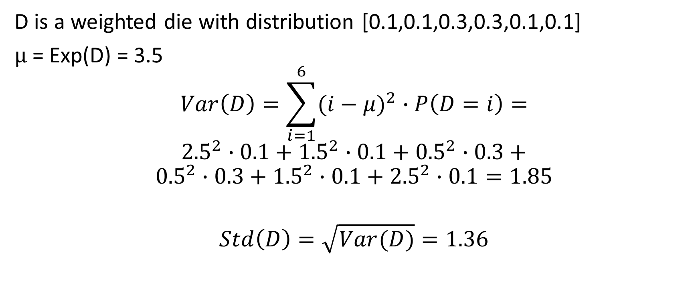
Examples of variance
D is a weighted die with distribution [0.1,0.1,0.3,0.3,0.1,0.1]
μ = Exp(D) = 3.5
$$Var\left(D\right)=\sum_{i=1}^{6}{(i−μ)^{2}∙P\left(D=i\right)}=$$
$${2.5}^{2}∙0.1+{1.5}^{2}∙0.1+{0.5}^{2}∙0.3+$$
$${0.5}^{2}∙0.3+{1.5}^{2}∙0.1+{2.5}^{2}∙0.1=1.85$$
$$Std\left(D\right)=\sqrt{Var(D)}=1.36$$

Slide 6
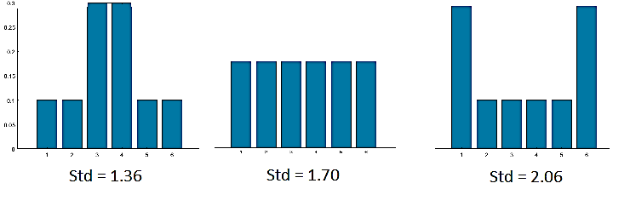

Slide 7
Properties of expected value and variance
X and Y are random variables; C is a constant.
Exp(X+c) = c+Exp(X)
Exp(c∙X)= c ∙ Exp(X)
Exp(X+Y) = Exp(X)+Exp(Y) whether or not X and Y are independent.
Var(X+c)=Var(X). Std(X+c)=Std(X).
Var(c∙X)= c² ∙ Var(X). Std(c∙X)= c ∙ Std(X).
Var(X+Y) = Var(X)+Var(Y) if X and Y are independent.

Slide 8
Particular parametrized families of discrete numeric distributions
Bernoulli distribution
Binomial distribution
Zipf aka inverse power law distribution

Slide 9
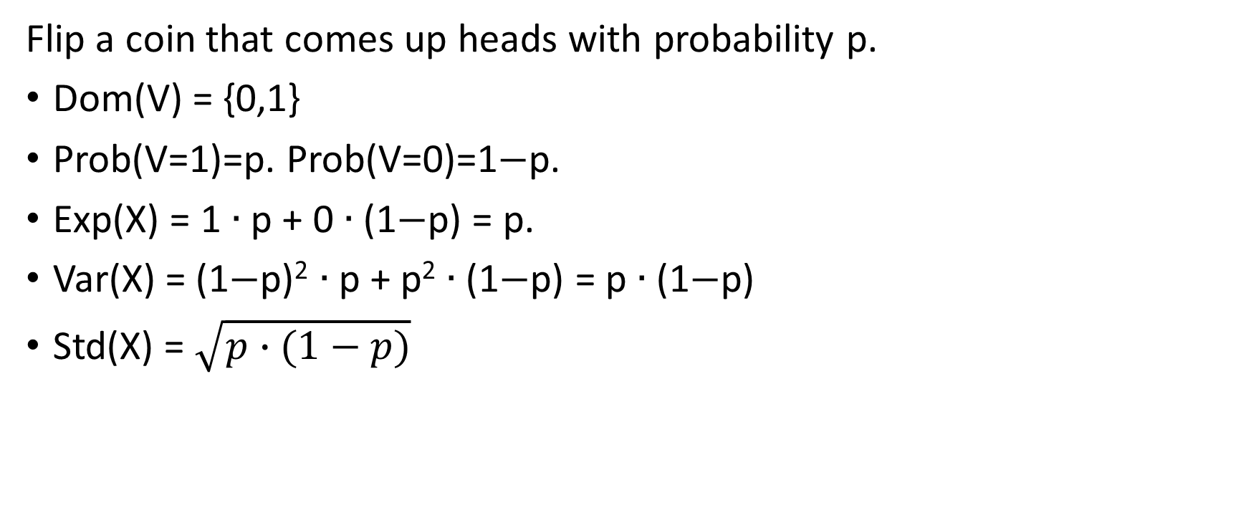
Bernoulli distribution with parameter p.
Flip a coin that comes up heads with probability p.
Dom(V) = {0,1}
Prob(V=1)=p. Prob(V=0)=1−p.
Exp(X) = 1 ∙ p + 0 ∙ (1−p) = p.
Var(X) = (1−p)² ∙ p + p² ∙ (1−p) = p ∙ (1−p)
Std(X) = $\sqrt{p∙(1−p)}$

Slide 10
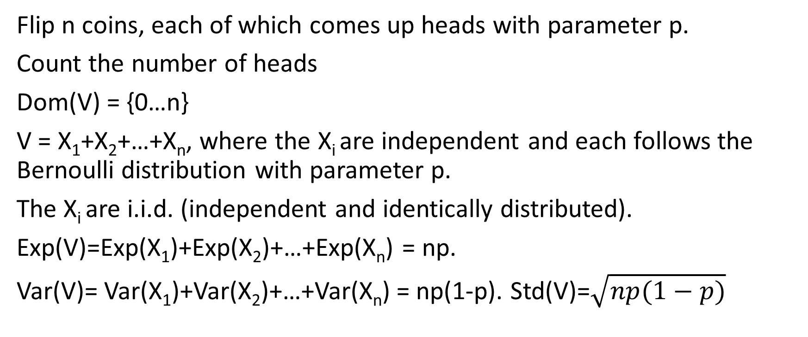
Binomial distribution with parameters n,p
Flip n coins, each of which comes up heads with parameter p.
Count the number of heads
Dom(V) = {0…n}
V = X₁+X₂+…+X_{n}, where the X_{i} are independent and each follows the Bernoulli distribution with parameter p.
The X_{i} are i.i.d. (independent and identically distributed).
Exp(V)=Exp(X₁)+Exp(X₂)+…+Exp(X_{n}) = np.
Var(V)= Var(X₁)+Var(X₂)+…+Var(X_{n}) = np(1-p). Std(V)=$\sqrt{np(1−p)}$

Slide 11
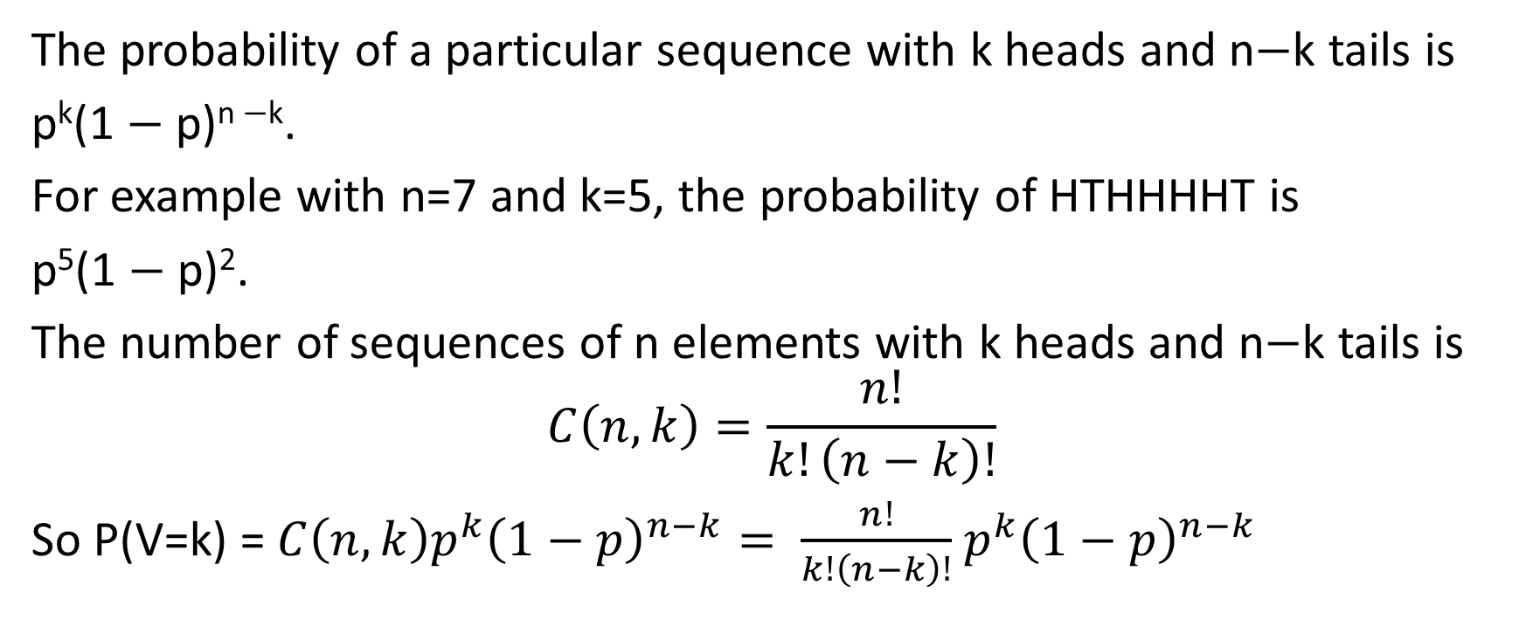
Computing the binomial distribution
The probability of a particular sequence with k heads and n−k tails is
p^{k}(1 − p)^{n −k}.
For example with n=7 and k=5, the probability of HTHHHHT is
p⁵(1 − p)².
The number of sequences of n elements with k heads and n−k tails is
$$C\left(n,k\right)=\frac{n!}{k!\left(n−k\right)!}$$
So P(V=k) = $C\left(n,k\right)p^{k}{\left(1−p\right)}^{n−k}= \frac{n!}{k!\left(n−k\right)!}$ $p^{k}{\left(1−p\right)}^{n−k}$

Slide 12
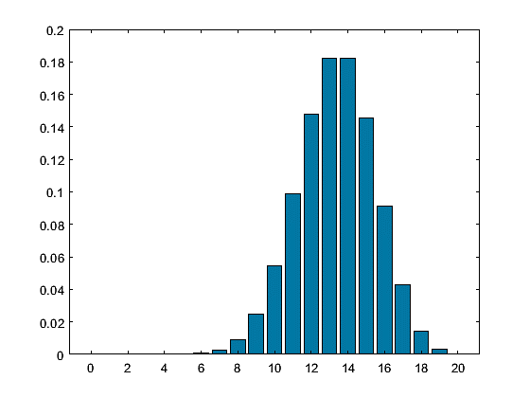
Binomial distribution, p=2/3, n=20

Slide 13
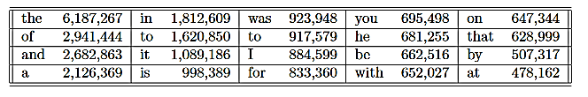
Zipf distribution – inverse power law
George Zipf (1902-1950)
Distribution of most frequent words in British National Corpus:
(100,100,000 word tokens; 938,000 different word types.)

Slide 14
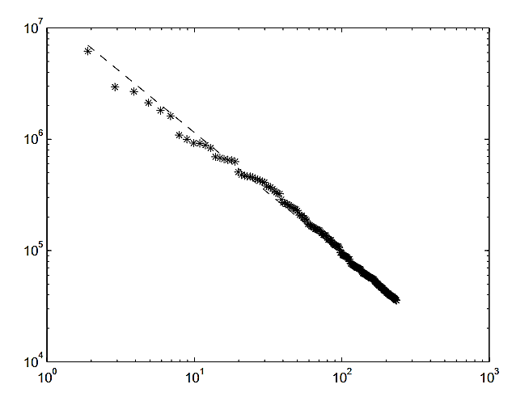

(Rank+0.89) vs. number on a log-log plot
$$y\left(n\right)=1395000∗{(n+0.8948)}^{−1.0854}$$

Slide 15

Why a log-log plot?
If $y=cx^{−α}$, then $\log{y}=\log{c−α\log{x}}$ so a straight line on a log-log plot.

Slide 16
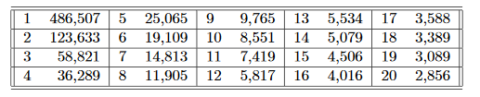
Number of rare “words”
(A lot of the ones that occur once or twice, are not actually words; they are misspellings, numbers, strange acronyms, rare names, random garbage …)
486,507 words occur only once.
123,833 words occur only twice.
Etc.

Slide 17
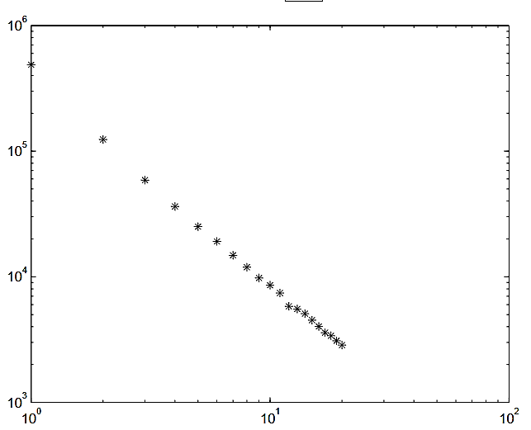

Rarity vs. number of words on a log-log graph
$$y=399,000∙n^{−1.669}$$

Slide 18
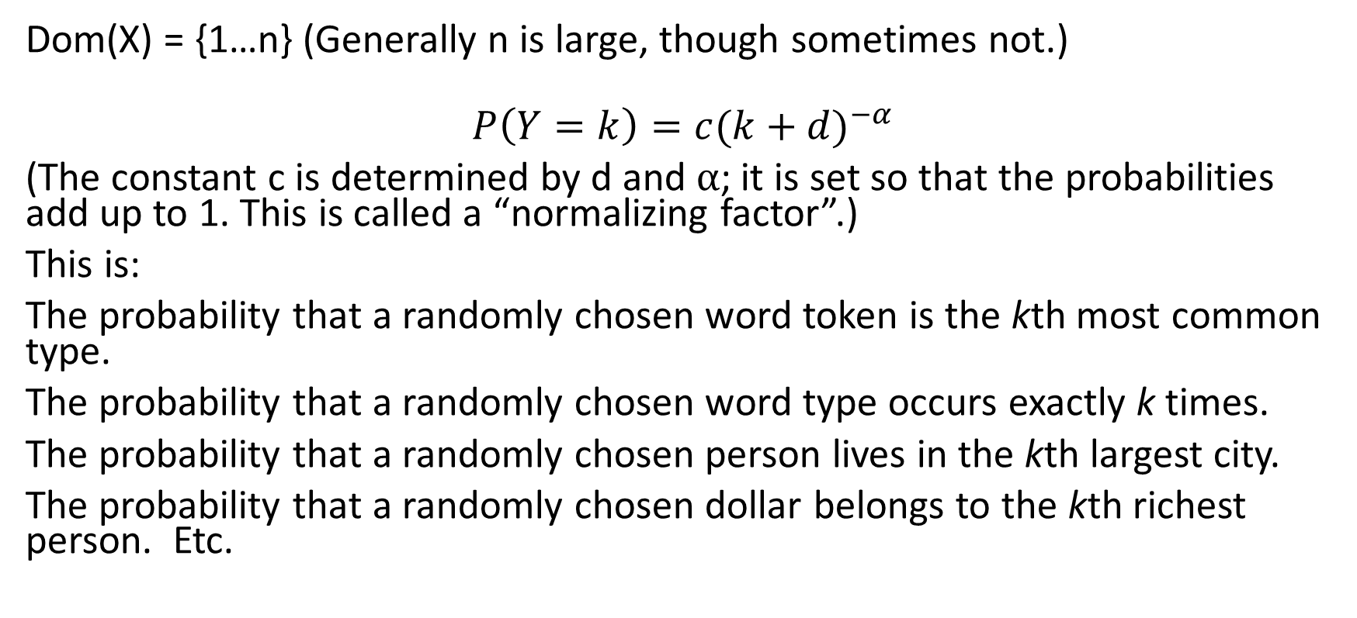
Zipf distribution: Parameters d and α
Dom(X) = {1…n} (Generally n is large, though sometimes not.)
$$P\left(Y=k\right)=c{(k+d)}^{−α}$$
(The constant c is determined by d and α; it is set so that the probabilities add up to 1. This is called a “normalizing factor”.)
This is:
The probability that a randomly chosen word token is the kth most common type.
The probability that a randomly chosen word type occurs exactly k times.
The probability that a randomly chosen person lives in the kth largest city.
The probability that a randomly chosen dollar belongs to the kth richest person. Etc.

Slide 19
Zipf’s law: A lot of things follow the Zipf distribution. (Though α≈2 is more common than α≈1)
Word frequencies
Frequency of k consecutive words
Inlinks to web pages
Outlinks from web pages
Connections to networks
Numbers of species/individuals in taxonomic categories
Number of citations to scientific papers
Number of images in a given category
Personal wealth
Personal income
Populations of cities
Magazine circulations
Number of viewers of a movie
Lengths of rivers
…

Slide 20
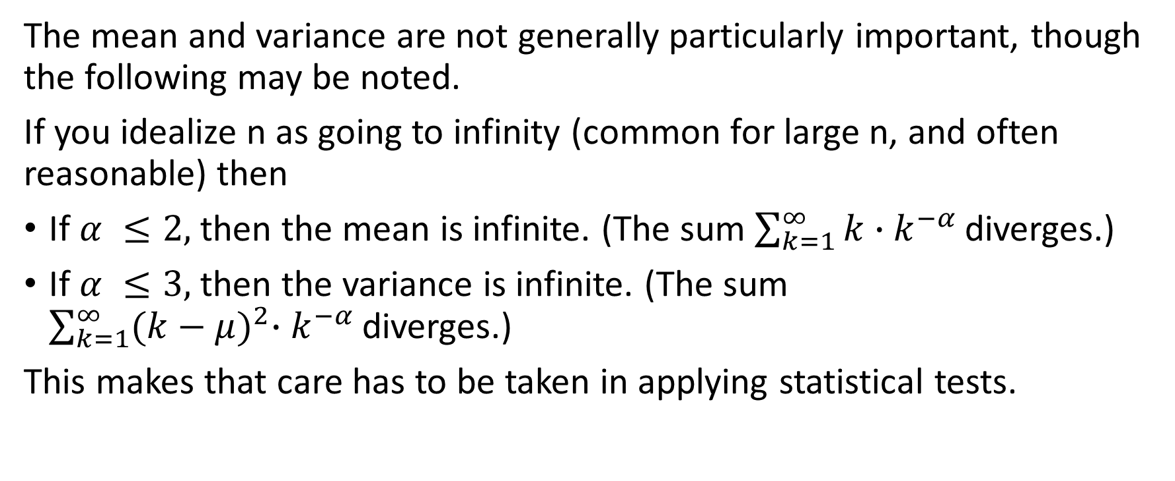
Zipf distribution features
The mean and variance are not generally particularly important, though the following may be noted.
If you idealize n as going to infinity (common for large n, and often reasonable) then
If $α ≤2,$ then the mean is infinite. (The sum $\sum_{k=1}^{∞}{k∙k^{−α }}$diverges.)
If $α ≤3,$ then the variance is infinite. (The sum $\sum_{k=1}^{∞}{{(k−μ)}^{2}∙k^{−α }}$diverges.)
This makes that care has to be taken in applying statistical tests.

Slide 21
The fat head: A fairly small number of things have most of the stuff.
The 10 most common words are 21% of the tokens.
The 20 most common words are 28% of the tokens
The 175 most common words are 50% of the tokens.
(The larger α, the stronger this effect.)

Slide 22
The long tail: A significant fraction of the stuff consists of things that are very rare.
Words that appear once are 0.5% of all word tokens
Words that appear at most ten times are 1.7% of all word tokens
Words that appear at most twenty times are 2.3% of the total.
Therefore, even if you have read through all but the last few words of the entire 100,000,000 word corpus, there is a 1/200 chance that the next word you read will be one you have never seen before.
(The smaller is α, the larger this effect.)

Slide 23
Consequence for AI
It is often the case that:
You can achieve impressively good results fairly easily, because you soon take care of the fat head.
It takes a long time and an immense amount of data to get to a really high level of performance, because of the long tail.

Slide 24
Continuous random variable
Most of the numerical random variables that are used in practice have a domain that is the real number line, or some real interval.
In that case, you can’t use the definition of probability over a sample space that we used in the last lecture, because the probability of any specific outcome is 0, and you can’t add up an infinite collection of 0s to get anything.
Instead:
If X is a continuous random variable, then the principal events associated with X have the form “a ≤ X ≤ b” or “a ≤ X” or “X ≤ b”.

Slide 25
Specifying a continuous random variable
There are two ways to specify the behavior of a continuous random variable:
The cumulative distribution (conceptually simpler)
The probability density (more similar to discrete probability, generally more useful in practice)

Slide 26
Cumulative distribution
The cumulative distribution of random variable X is the function F(b) such that F(b) = P(X ≤ b)
Properties of the cumulative distribution.
F is monotonically non-decreasing; If c < d, then F(c) ≤ F(d).
lim_{b→-∞} F(b) = 0. lim_{b→∞} F(b) = 1.
We will assume that the probability of a particular value P(X=c)=0 for all c. Under that assumption
F is continuous.
Any function satisfying these three constraints is a legitimate cumulative distribution.

Slide 27
Calculating events from cumulative distribution
If X has cumulative distribution F(b) and F(b) is continuous then
P(X ≤ b) = F(b).
P(a ≤ X) = 1 − F(a).
P(a ≤ X ≤ b) = F(b) − F(a).

Slide 28

Probability Density
The probability density of random variable X at value c is a function f(c) such that f(c) is the probability that X is “very close” to c, divided by the distance “very close”.
f(c) = lim_{ε→ 0} [P(c−ε < X < c+ε )]/2 ε
Properties of the density:
f(c) ≥ 0 for all c.

Slide 29

Relation of the cumulative distribution and the density.
If the cumulative distribution of X is F(b) and F is piecewise differentiable and continuous, then
X has a well-defined probability density f(c).
f is the derivative of F.
F is the integral of f.

Slide 30
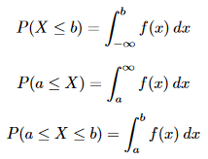
Calculating events from the density

Slide 31
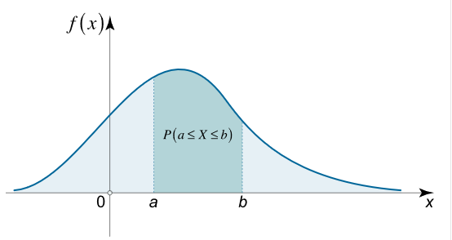
Event from density
If the density of X is f(c), then Prob(a ≤ X ≤ b) is the area between a and b under the curve f(c).

Slide 32

Notation. Extension of concepts.
I will write
to mean the probability density of X at c.
(This is not standard notation AFAIK; just my own “excess of caution”. I get nervous about abuse of notation.)
The definitions of conditional probability and of independence are the same as in the discrete case.

Slide 33

Expected value of continuous random variable
The expected value is again the average that you expect to get if you sample the random variable many times. The summation in the discrete case turns into an integral in the continuous case.
The expected value theorem still holds: Exp(X+Y) = Exp(X) + Exp(Y), whether or not X and Y are independent.

Slide 34
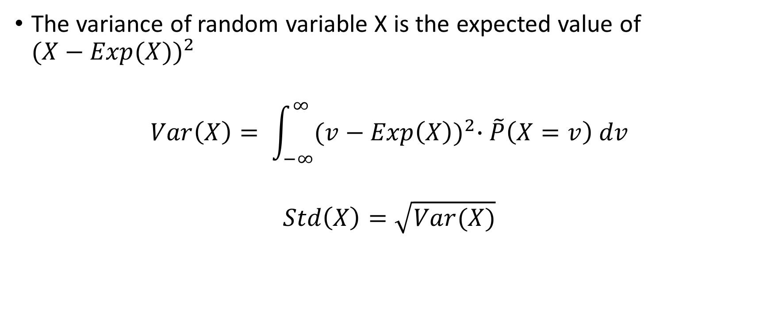
Variance of a continuous random variable
The variance of random variable X is the expected value of $({X−Exp(X))}^{2}$
$$Var\left(X\right)= \int_{−∞}^{∞}{{(v−Exp\left(X\right))}^{2}∙\tilde{P}\left(X=v\right) dv}$$
$$Std\left(X\right)=\sqrt{Var(X)}$$

Slide 35
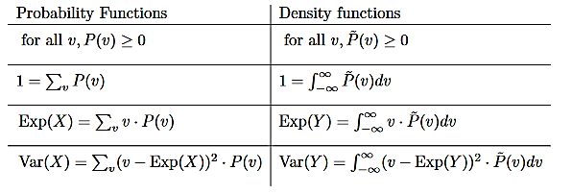
Similarities of probability density and discrete probability
Similarities:

Slide 36
Differences between probability density and discrete probability
Probabilities are at most 1. Probability density can be greater than 1. For example, the uniform distribution between 0 and 0.5 has density 2.
P(g(X)=g(v))=P(X=v) if X is a discrete r.v. and g is one-to-one. Does not hold for probability density.
For instance, consider the case g(v)=3v.
If we consider the simple discrete case of an r.v. X with values 0 and 1, each with probability ½, then g(X) has two values 0 and 3, each with probability ½.
By contrast if X is the uniform distribution between 0 and 1, then the density at every point between 0 and 1 is 1. But g(X) is the uniform distribution between 0 and 3, and the density at every point is 1/3.

Slide 37
Two important families of continuous probabilities.
The uniform distribution between L and U.
The normal distribution with mean μ and standard deviation σ.

Slide 38
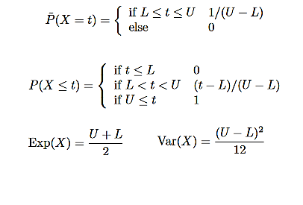
Uniform distribution
The uniform distribution has two parameters, L and U where L < U.
If X follows the uniform distribution between L and U, then its value is certainly between L and U, and all values between L and U are equally likely.

Slide 39
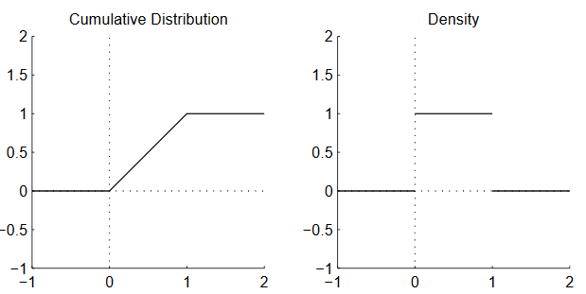
Uniform distribution between 0 and 1

Slide 40
Normal distribution
The normal distribution N_{μ,σ} (aka the Gaussian distribution; the bell curve) has two parameters: the mean μ, which can be any number, and the standard deviation σ, which can be any positive number.
Lots of things follow a normal distribution, if there is a central value plus some kind of variance or noise. (Though often there are more “outliers” --- extreme values --- than the distribution predicts.)
Experimental measurements, including noise.
Results of polling a sample of the population.
Natural variation in a homogeneous population (e.g. biometric data).
Variation in manufactured products e.g. length of nails.

Slide 41
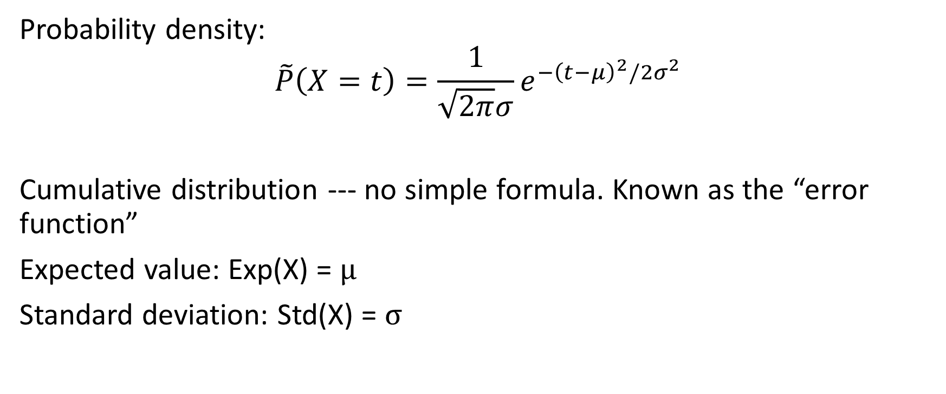
Normal distribution -- formula
Probability density:
$$\tilde{P}\left(X=t\right)=\frac{1}{\sqrt{2π}σ}e^{−{\left(t−μ\right)}^{2}/2σ^{2}}$$
Cumulative distribution --- no simple formula. Known as the “error function”
Expected value: Exp(X) = μ
Standard deviation: Std(X) = σ

Slide 42
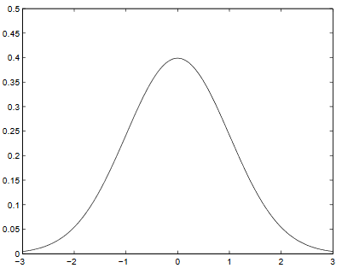
Normal distribution --- parameters
The density function for normal distributions are all essentially the same shape. They differ in where they are centered (controlled by μ) and how wide they are (controlled by σ).

Slide 43
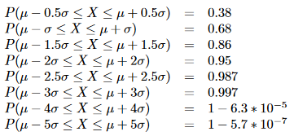
Likelihood that the value is close to μ

Slide 44
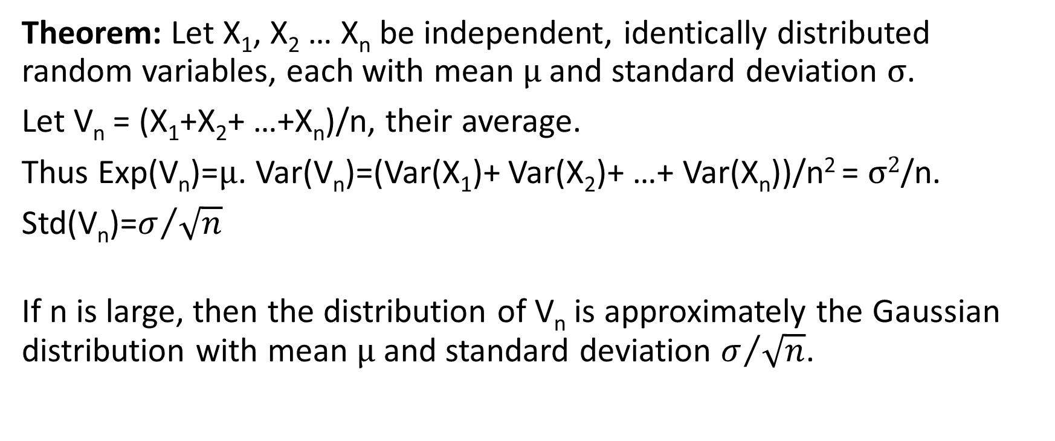
Central limit theorem
Theorem: Let X₁, X₂ … X_{n} be independent, identically distributed random variables, each with mean μ and standard deviation σ.
Let V_{n} = (X₁+X₂+ …+X_{n})/n, their average.
Thus Exp(V_{n})=μ. Var(V_{n})=(Var(X₁)+ Var(X₂)+ …+ Var(X_{n}))/n² = σ²/n.
Std(V_{n})=$σ/{\sqrt{n}}$
If n is large, then the distribution of V_{n} is approximately the Gaussian distribution with mean μ and standard deviation $σ/{\sqrt{n}}$.

Slide 45
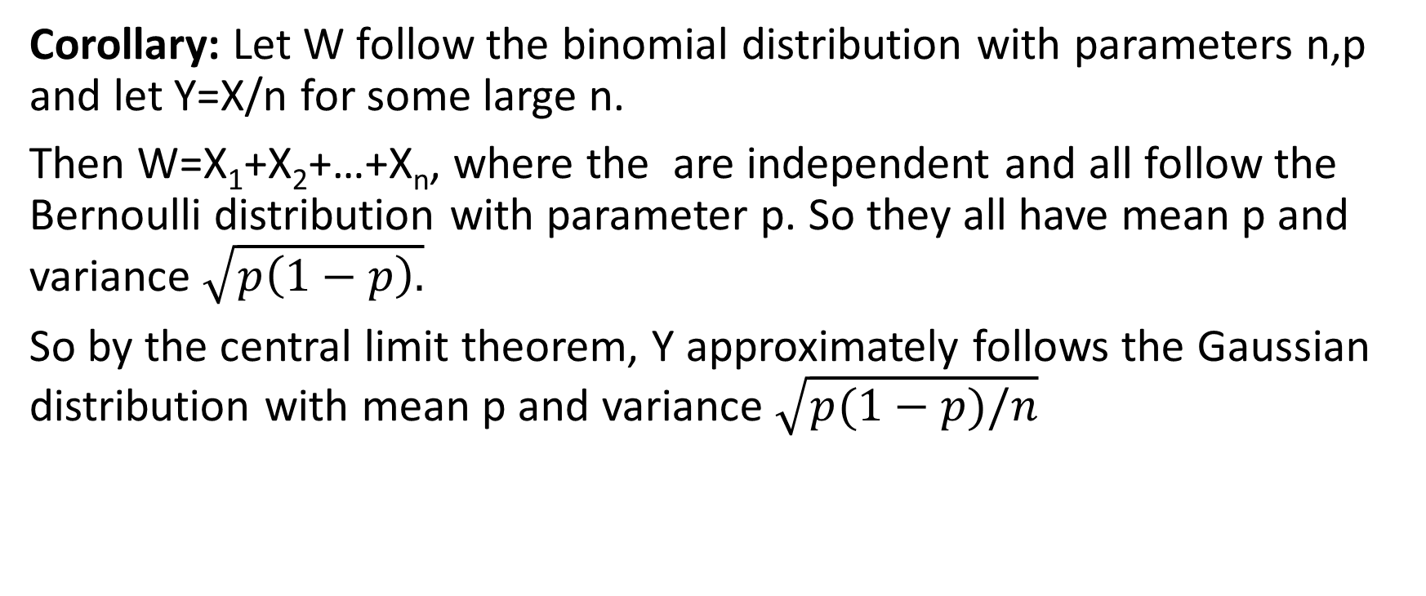
Central limit theorem
Corollary: Let W follow the binomial distribution with parameters n,p and let Y=X/n for some large n.
Then W=X₁+X₂+…+X_{n}, where the are independent and all follow the Bernoulli distribution with parameter p. So they all have mean p and variance $\sqrt{p\left(1−p\right).}$
So by the central limit theorem, Y approximately follows the Gaussian distribution with mean p and variance $\sqrt{p(1−p)/n}$

Slide 46
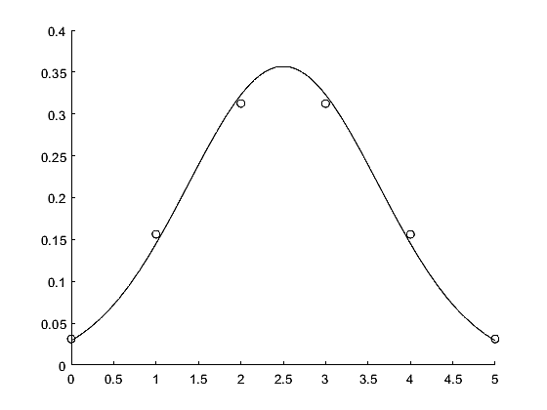

Comparison of binomial distribution to Gaussian
The dots are the binomial distribution with n=5, p=0.5.
The curve is the Gaussian with $μ=2.5,σ=\sqrt{5}/2.$

Slide 47
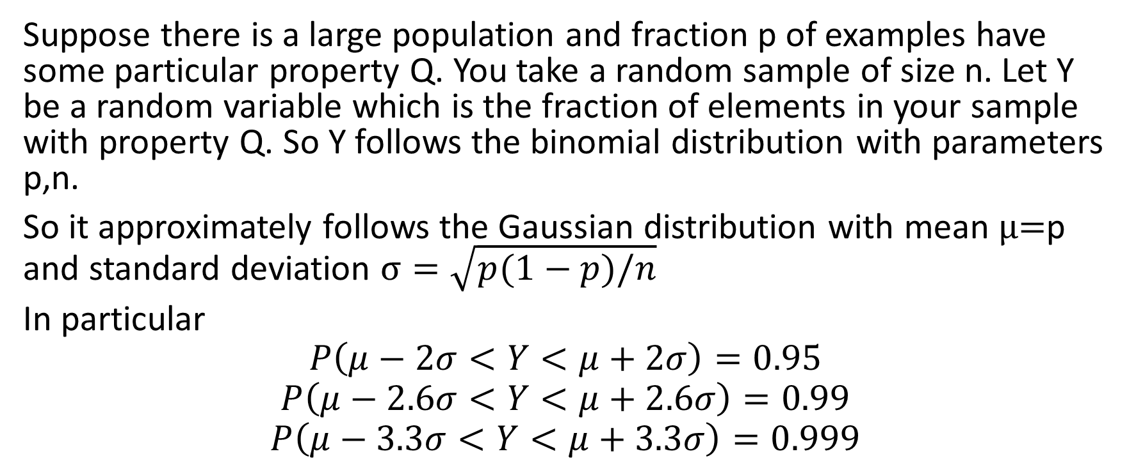
Polling
Suppose there is a large population and fraction p of examples have some particular property Q. You take a random sample of size n. Let Y be a random variable which is the fraction of elements in your sample with property Q. So Y follows the binomial distribution with parameters p,n.
So it approximately follows the Gaussian distribution with mean μ=p and standard deviation $σ=\sqrt{p(1−p)/n}$
In particular
$$P\left(μ−2σ<Y<μ+2σ\right)=0.95$$
$$P\left(μ−2.6σ<Y<μ+2.6σ\right)=0.99$$
$$P\left(μ−3.3σ<Y<μ+3.3σ\right)=0.999$$

Slide 48
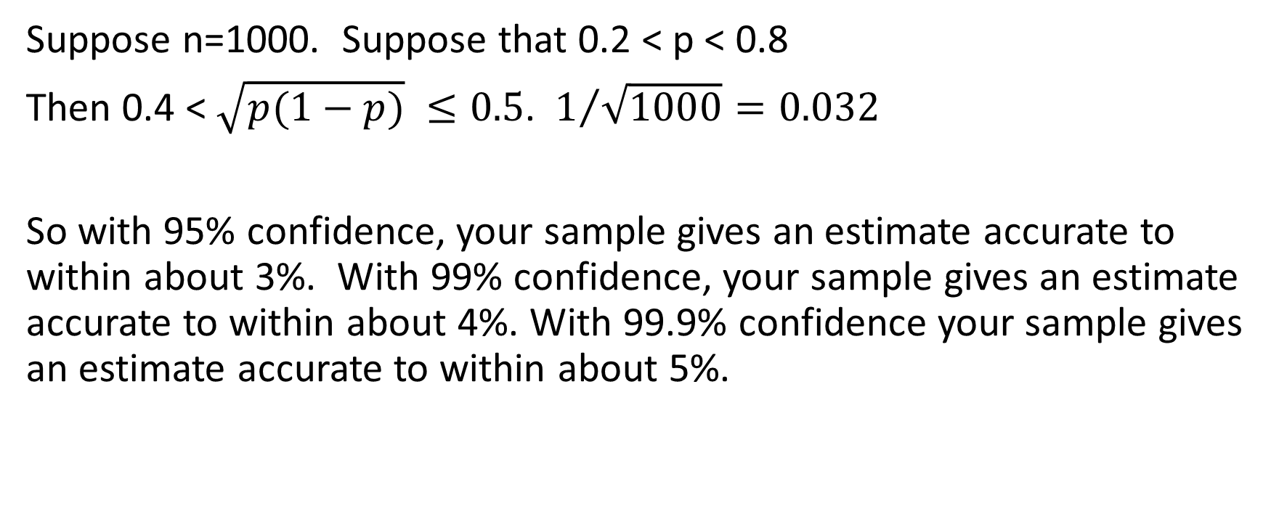
To be concrete
Suppose n=1000. Suppose that 0.2 < p < 0.8
Then 0.4 < $\sqrt{p(1−p)} ≤0.5$. $1/{\sqrt{1000}=0.032}$
So with 95% confidence, your sample gives an estimate accurate to within about 3%. With 99% confidence, your sample gives an estimate accurate to within about 4%. With 99.9% confidence your sample gives an estimate accurate to within about 5%.

Slide 49
End of probability section of the course

